Slide 1
ISO Certificated
Luoyang Hefeng Office Furniture Co., Ltd
- Professional Steel Furniture Manufacturer
Company Profile
23 Years' Focus on Steel Furniture

Slide 2
CONTENTS
1
2
3
4
5
2
Company Overview
Factory Tours
Product Range
Export Market
Contact
Us

Slide 3
PART
01
Company
Overview

Slide 4
Profession
Innovation
Quality
Who We Are?
Hefeng Introduction
Luoyang Hefeng Office Furniture Co., Ltd is a leading manufacturer and exporter of Filing Cabinets, Steel Lockers, Workshop Cabinets, Library Shelving, Office Desk and some other related steel furniture in China. All of the products are strictly in conformity with ISO9001, ISO45001 certifications and have got a lot of acclaims from customers all around the world.
The factory now covers an area of 50,000 square meters and has 8 medium workshops. With the advanced technology, high-automation molded production and strict quality control system, the products are quality-constant in mass production and the monthly output reaches to 30,000 pieces.

Slide 5
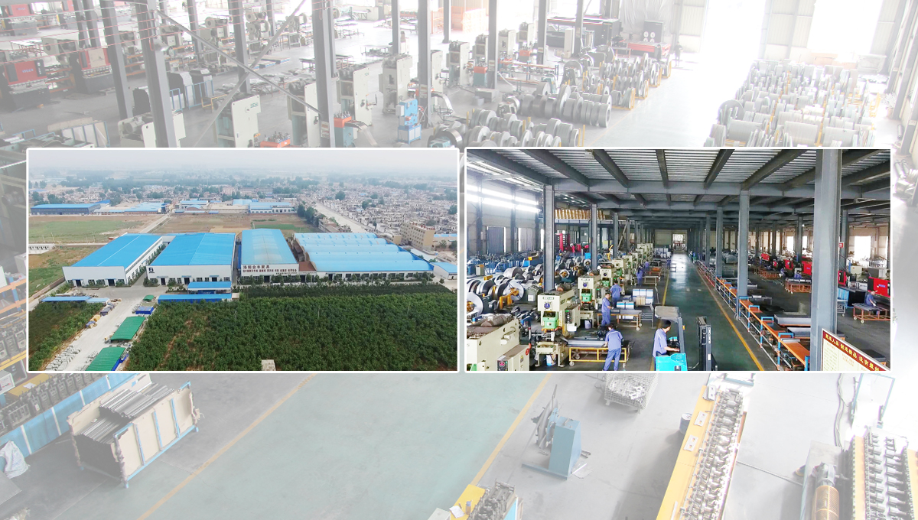

Slide 6
Powerful Team
Solidarity & Profession
11 Administrative Staff
With rich management experience and up-to-date view.
22 Technical Personnel
60% of them have been working in Hefeng for over 10 years.
25 Professional Service Staff
Serious and responsible, young and dynamic.
410 Experienced Workers
Less than 5% stuff turnover rate each year.
Staying true to our founding mission
With experienced workers and professional customer service team, Hefeng people are here to provide superior products and services, to ensure that whatever customers need and whenever they need it could be guaranteed.

Slide 7
Consistent Aim
With the effective management, high-quality engineering team and advanced equipment, Hefeng Furniture insists on the independent R&D capacity in order to ensure the technical storage and constantly improve our technology and workmanship independently.
Innovation & Development
01
02
Target
03
7S & Lean Management
7S and lean management helps to create value and improve efficiency and quality by optimizing resources.
Professional Engineering Team
Senior experts and backbone designers have on average over 10 years' experience in development and design of steel furniture industry.
Mature & Perfect Product
Market-oriented, provide complete series of steel office furniture products to comprehensively satisfy customers’ demand for use.
High Quality Material Suppliers
Long term cooperation with superior steel sheet suppliers and the high-quality suppliers of furniture accessories such as locksets , powder coating etc., to ensure the product quality on leading position in the industry.
Advanced Equipments Support
World-class advanced production equipment, strong capability of R&D and manufacturing, strict quality control system during the production process , builds up a production system with unlimited energy.

Slide 8
Development History
Smooth & Steady
New Painting Line
Fast Growing
We set up a new powder painting line with technology from Swiss GEMA, which hugely improved the surface powder coating quality of steel furniture.
With 368 Employees, we had exported to 87 countries all over the world.
JF Furniture
Set up our subsidiary company named “Luoyang Jin Feng Office Furniture Co.,Ltd”
48 Distributors
Starting
JF Furniture became a fast growing brand,we have 48 distributors all over China.
2012
We built a small workshop with 20 worker and one production line mainly manufacturing Metal Filing Cabinet.
2013
2003
2009
1999

Slide 9
New Developing
New equipment
Advanced & Outstanding
Hefeng Furniture is pleased to continue its commitment to improving the Product Quality and Production Capacity by adding the latest Amada HG 1303 Press Brake and a new Powder Coating System.
Salvagnini P2lean
Automatic Feeder
With the fast development of factory, we have bought in two Salvagnini P2lean bending machines and a new CNC AMADA bending machine with the system of a robot.
With the application of new manufacturing equipment – Automatic Feeder ASR2512N & Product Integration System VPSS, the work efficiency has been greatly improved. The factory realizes 24-hour unattended automatic production in material feeding, processing and changing.
CNC Machine
Introduced another three sets of CNC bending machines from AMADA.
Import AMADA
2018
Imported full sets of AMADA CNC punching machine, CNC bending machine and Laser Cutting machine from Japan.
2020
2015
2016
2014

Slide 10
ISO Certificates
ISO14001, ISO45001, ISO9001

Slide 11
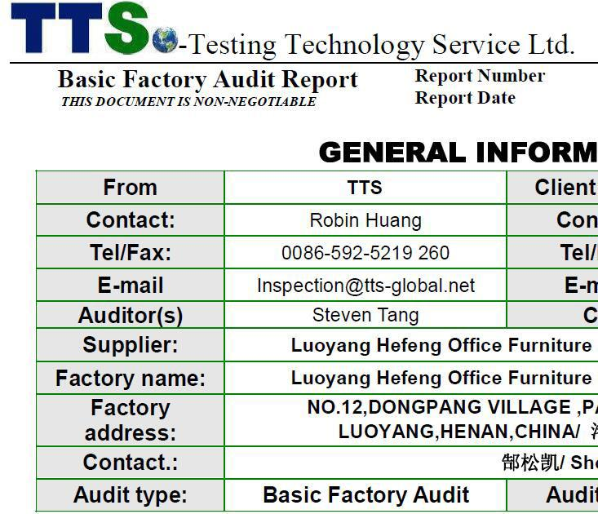
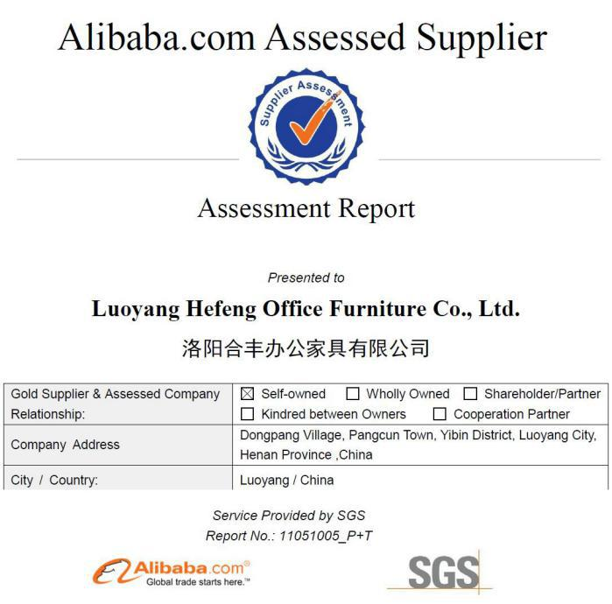
Qualifications
SGS, TTS Assessment

Slide 12
PART
02
Factory
Tours

Slide 13
Production Process
How Do We Make Steel Furniture?
Decoiler
Cutting
Mould Stamping
CNC Punching
CNC Bending
Welding
Surface Treatment
Powder Coating

Slide 14
Production Process
How Do We Make Steel Furniture?
Packaging
Warehousing
Loading
Delivery
From raw materials, to cutting, punching, bending, spot welding, painting and assembling, the focus on details of each step ensures the quality of every piece of Hefeng products.
The green avenue beside the production workshops witnesses the trailers, one by one, with perfectly packaged and neatly arranged products inside that will take lorries, trains or oceangoing freighters to travel to more than 87 countries all over the world.

Slide 15
Raw Material Distribution Center
SPCC First Level Sheets
Stable Supply
Shandong Guanzhou CO., Ltd and HBIS (Handan Iron & Steel Group Co., Ltd) are our signed suppliers of metal sheets, from which we bring in 800 tons and 1000tons of steel sheets respectively each month. Both of them are big factories with annual output of 40,000 tons.
The metal sheets we are using are SPCC first level laser roughen sheets, which can increase the area and intention of the painting, so the product surface after painting will be more even and smooth.

Slide 16
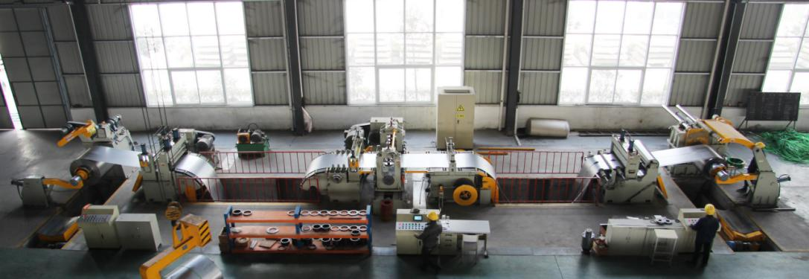
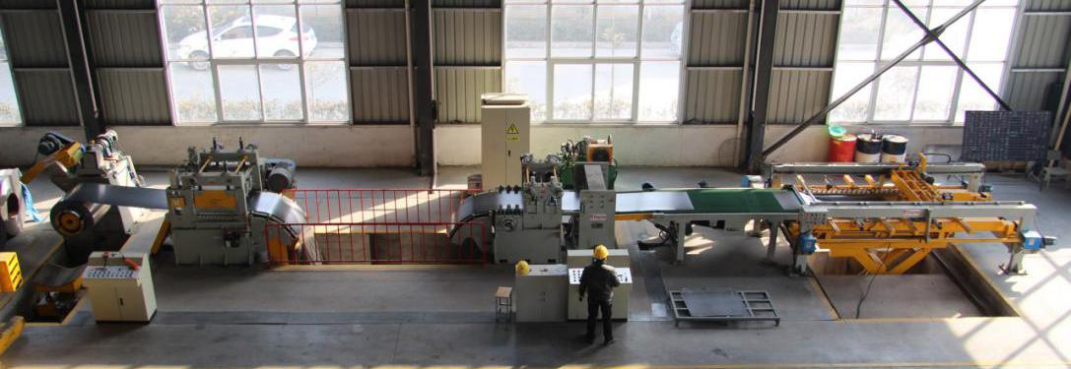
Metal Shearing Area
Slitting & Cross Cutting
Slitting machine: cut the volumed materail into strip plate with a certain size by lengthways .
* Convenient operation
* High utilization of materail
* High cutting precision
* Max 1.4m width & 1.5mm thickness
Cross cutting machine: cut the processed strip plate into a certain length as needed and stack them
* High degree of automation
* Simple and stable operation
* Max 1.4m length & 1.5mm thickness

Slide 17
Materail Feeding Center
NC Servo Feeding System
* These machines are NC Servo feeding system matched with SEYI high precision punching machines, 30 sets in total.
* Each machine is operated by a professional worker.
* These machines can process accessories, such as hinges, clothing hangers and some parts of drawers cabinet.
* With precision of 0.03mm, they can even be used for processing watch parts.

Slide 18
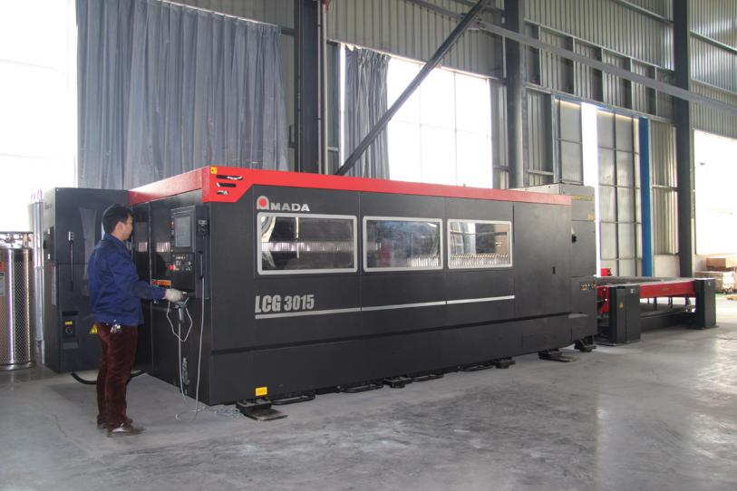
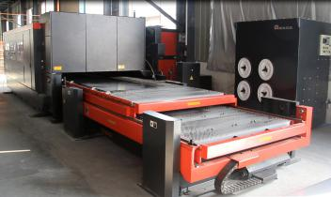
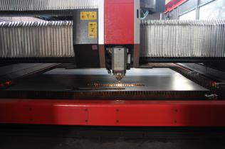
AMADA CNC Machines
Full Sets of Laser Cutting, Punching, Bending
First Class Cutting Ability
* Processing range: 1.5*5 meters;
* Precision: 0.01 to 0.03mm;
* With OVS camera, connected with the CNC punching machine.
LCG3015 AMADA Laser Cutting Machine

Slide 19
CNC Punching Machine
* AE2510NT & EMZ3610NT
* 58 stations and 58 sets of molds can be installed
* Two 360 degree rotating locations
* Punching speed of each mold is 900 times/min
* Precision is plus or minus 0.01mm
产 品 策 略 1
We have 3 sets of AMADA CNC Punching machines with mature turret punching technology, which are used to stamp the material after cross cutting to a certain shape.

Slide 20
CNC Bending Machine
We have 4 sets of AMADA CNC bending machines, 3 of which are equiped with two axes that can complete some workpieces which other domestic models can't do. The X axis is used to control the press angle, Y axis is used to control the size. The other one is equipped with nine axes which can bend any shape one requests.
产 品 策 略 1
产 品 策 略 2
Applied to multi-angle or circular-arc bendings.
Processing range is 3mx100 tons of pressure.
Larger processing range, higher processing efficiency, maximum precision guarantee.

Slide 21
Robotic Bending System
AMADA HG 1303 Rm
This automated bending system provides consistent, high-quality parts and process reliability while eliminating time-intensive, manual handling of large parts.
Highly-complex parts and small lot sizes can also be processed efficiently and accurately by the HG Rm.
Additional features and benefits include:
* Highly-accurate robotic bending system built on AMADA's HG Series of press brakes
* 6-axis robot with 8-meter track provides versatile loading and unloading options
* Potentiometer backgauge system ensures high-precision bending operations
* Intuitive offline programming software
* Energy efficient
The HG 1303 Rm Robotic Bending System
was designed specifically for processing large parts — which typically
require two operators to safely handle or are difficult to manage by a single operator.

Slide 22
Salvagnini P2lean
Panel Bender
Flexible bending solution
* Be able to process the steel plate with thickness from 0.4mm to 3.2mm.
* The maximum bending length and width can be up to 2495mm x 1600mm.
* Special-shaped products can be customized.
* Highly efficiency, completes an average of 17 bends per minute.
* Totally automatic, it guarantees 100% quality parts.
* Realize mass production, can meet the requirement of large projects.
Flexible automation, sustainable technology, adaptive system and connectivity 4.0, the P2lean is the ultimate panel bender able to efficiently produce a large variety of parts.
Totally automatic, it guarantees that the first part is a good part.

Slide 23
Automatic Deliver Material Machine
AMADA ASR2512N
Each layer can bear steel plates with weight of 2 tons.
The plates can be automatically processed, replaced and displayed with this machine. It can operate 24 hours a day without stopping.
Connecting with the AMADA CNC Punching machine， it can reduce labor force and improve work efficiency.
6 Layer Automatically Delivering Material System

Slide 24
Spot Welding
TIG, MIG, CNC Spot Welding
* We have 28 sets of spot welding machines. Among them, there are 8 sets of CNC pneumatic spot welding machines, and 1 set of carbon dioxide protection welding machine.
* CNC spot welding machines can precisely adjust the electric current intensity and the length of the welding time, so the welding fastness is assured. * Carbon dioxide protection welding machine fuse the welding wire at an instant, then isolated from oxidation to prevent air bubbles, so as to protect the products. It is mainly used for welding door angle and some parts that are not easy to weld.

Slide 25
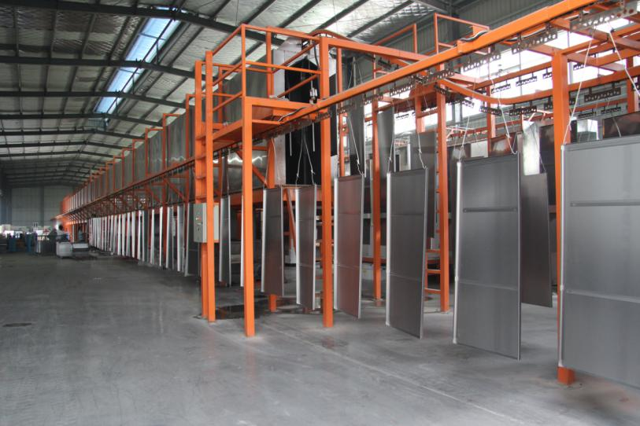
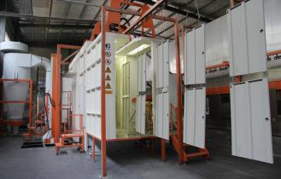
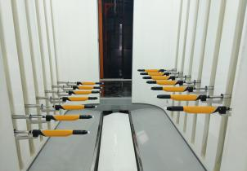
Automatic Powder Coating
GEMA Automatic Spray Gun
3 Power Coating Lines
* Switzerland GEMA automatic spray gun
* 9-station pretreatment
* Powered by gas, environmentally friendly
* Better electrostatic absorption , high rate of powder coating, saving cost, and good powder spraying effect
500-meter Germany Powder Coating Line

Slide 26
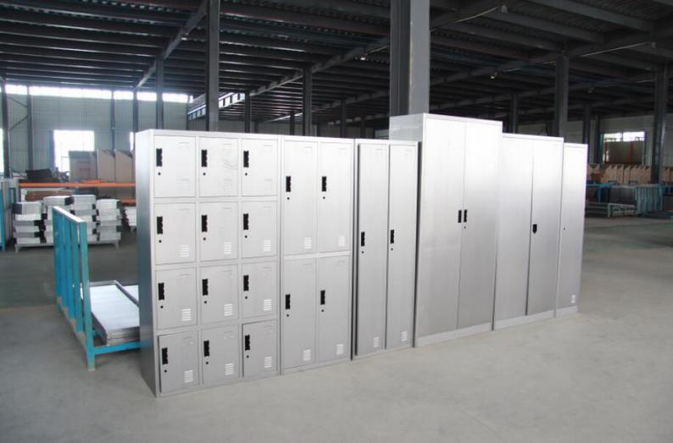
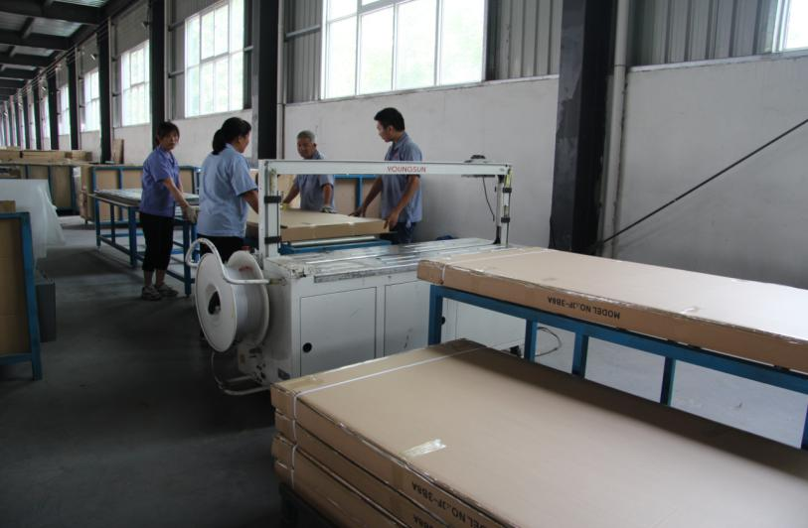
Trial assembly & Packaging
Strict Quality Control Before Painting and Delivery
Control the product quality and reduce the rate of defective products before painting and delivery.
* Before each batch of mass production, we will assemble some products in advance, and test the forming conditions.
* Mass production won't be started until the precision is adjusted.
* Five sets of automatic packing machines.
* Packing was optimized and confirmed after dozens of tests, so it is very solid, and can withstand the bumpy shipment.

Slide 27
Strict Quality Control
Professional Laboratory for Testing
Thickness Gauge Test
Gloss Test
Grid Test for Adhesion
Punching Resistance Test
Anti-corrosion Test
70μm +-10μm
25-30% at 60°angle
First Level
50cm on both sides
By Salt Spray

Slide 28
Raw Material Supplier
From International Well-known Brands

Slide 29
PART
03
Product
Range

Slide 30
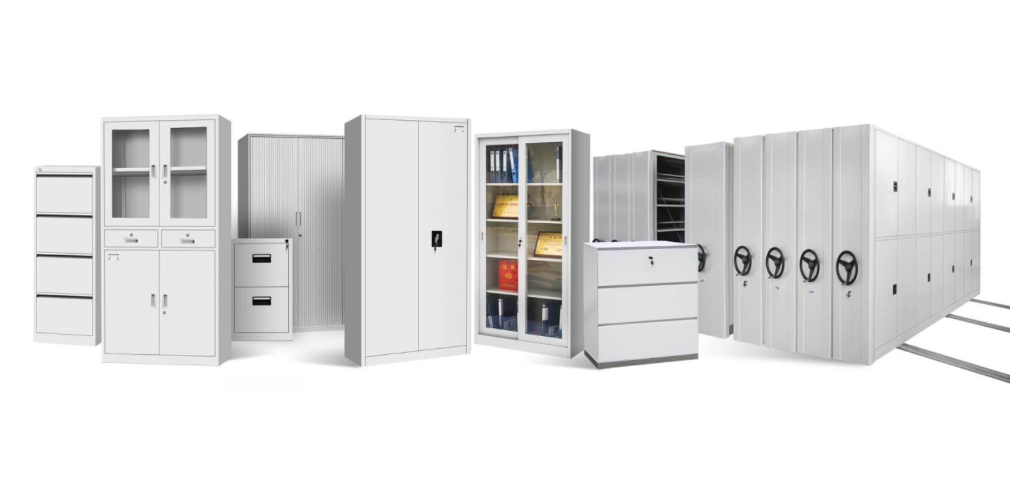
Drawer cabinet, filing cabinet, glass door cabinet, sliding door cabinet, roller shutter door cabinet, mass shelving, etc., various kinds of metal cabinets for your option.
Steel Cabinets

Slide 31
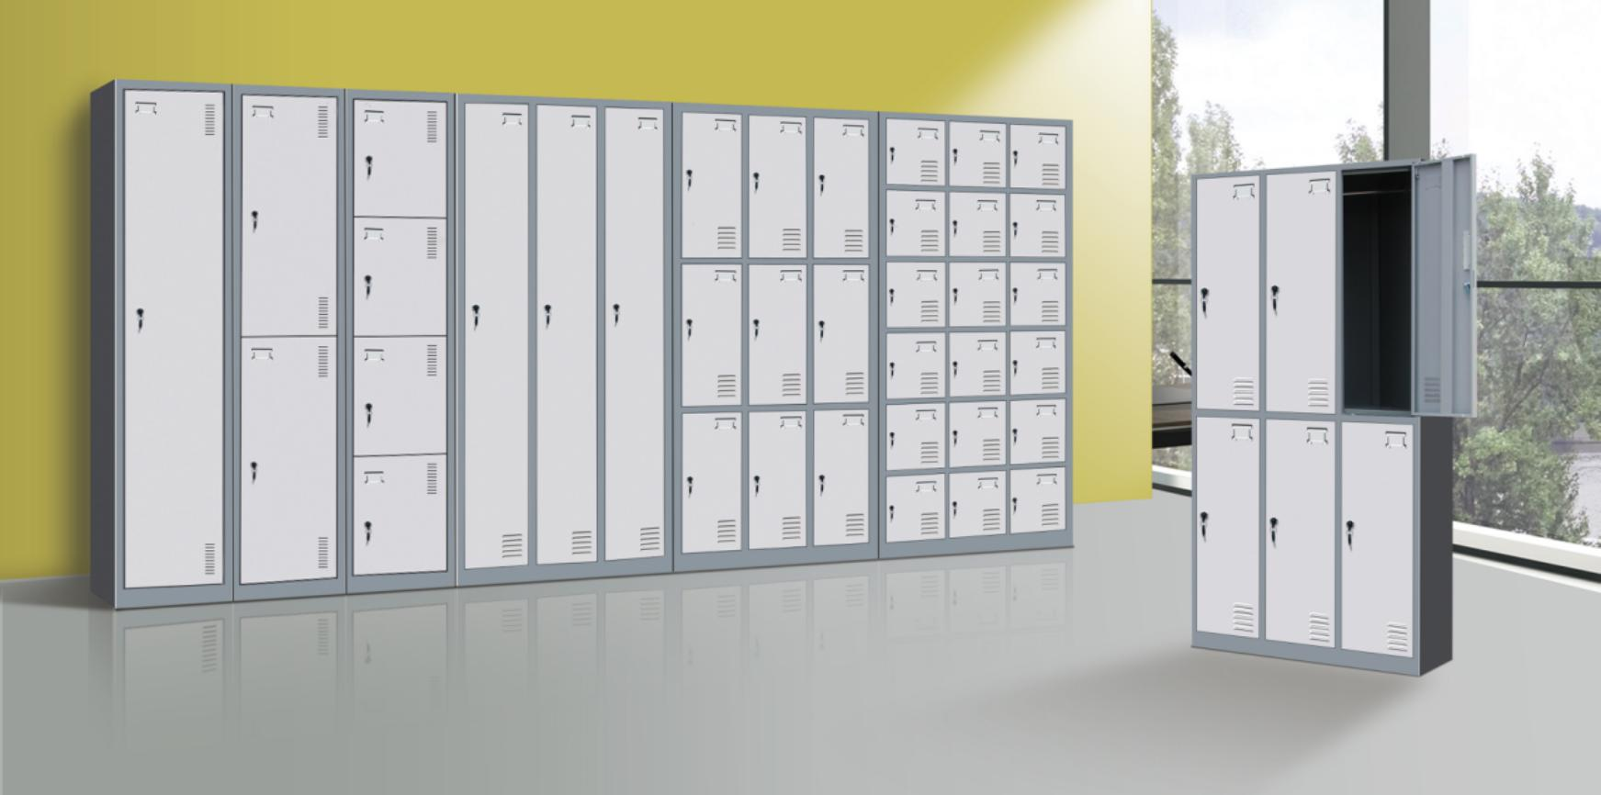
Tier locker, Z-shape door locker, school locker, home use wardrobe, different types of metal lockers are available.
Steel Lockers

Slide 32
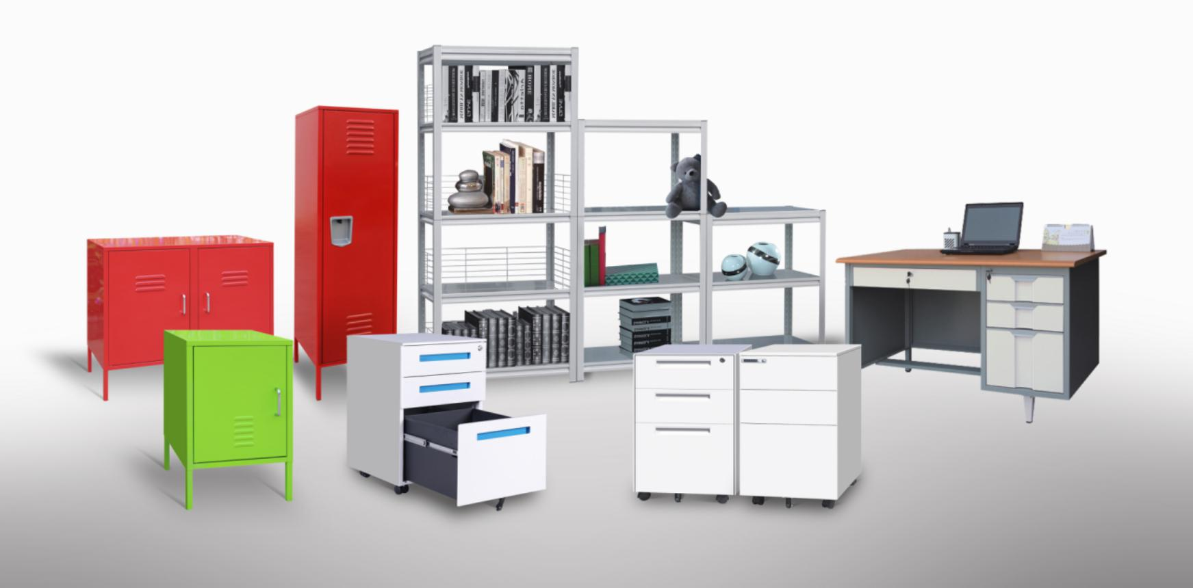
If you can not find the item you need among our commen products, don't worry, we will be able to make the items according to your draft ideas, specification or drawings.
Customized Steel Items

Slide 33
Product Features
OEM, ODM Available
Subtitle Text Goes Here
Creative Design
Based on common products, pursuing new impressive design forever.
What Can Hefeng Supply?
Knock Down
Smaller packing, firmed package, saving cost and avoid damge.
Steel Locker
Filing cabinet
Office table
Steel shelving/rack
Workshop cabinet
Other steel products you are looking for
Environmentally
Friendly
Reduce pollution, protecting your health as well as the documents or belongings.

Slide 34
Hot Sale Items
4 Drawer File Cabinet
* Anti-tilt mechanism * Central control locking system * 40kgs loading capacity per drawer * 3-section ball bearing sliders with full extension
* Movable divider for adapting different hanging files * Knock down structure, transportation cost saving * Easy to clean surface
Item | Description
Size | H1320 x W460 x D620mm
Thickness | 0.5~0.8mm
Color | RAL 7035
Weight | 39.5 kgs
Volume | H1350 x W650 x D85mm = 0.0751m³
Loading Capacity | 45 kgs per drawer
JF-V04/V04A

Slide 35
Steel File Cabinets
No matter what you want is office file cabinet with swing doors, glass doors, sliding doors or metal cupboard with multi-function, Hefeng is ready for providing you with all items you need.
JF-C01
JF-C11
JF-C34

Slide 36
JF-SD01
JF-SD02
JF-T01

Slide 37
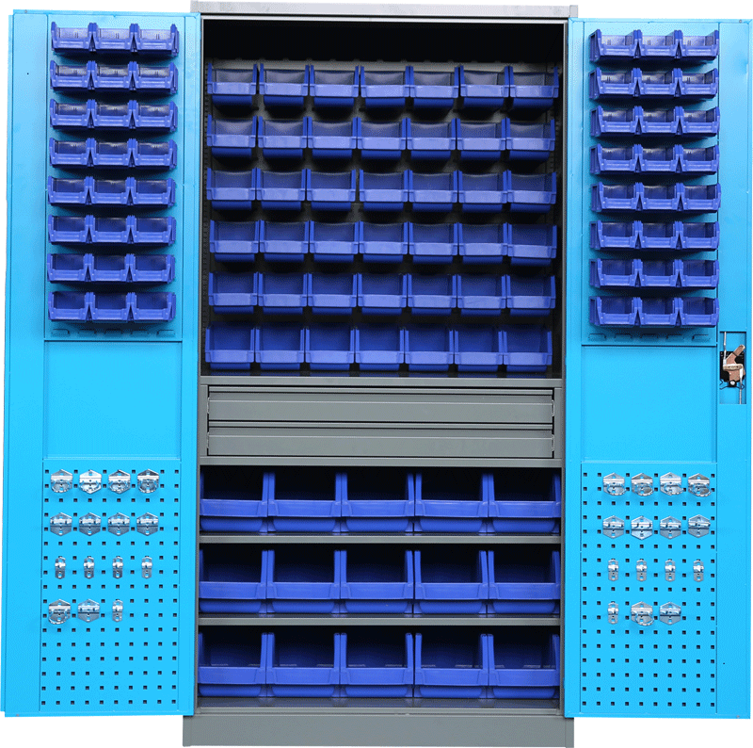
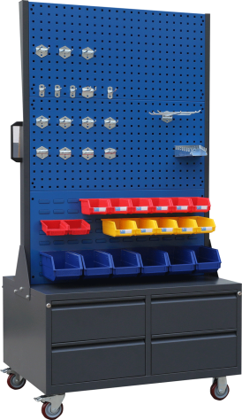
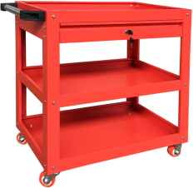
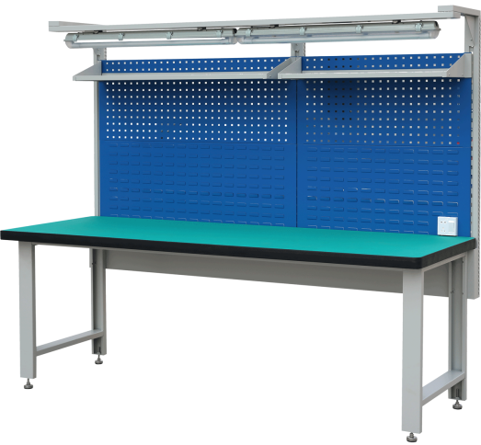
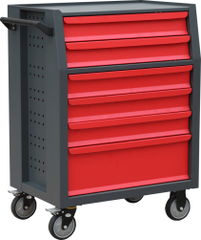
Tool Storage Series
Find great value tool cabinets, tool chests, rolling tool cart, pick rack, workstation, etc for the home workshop through to professional use at Hefeng Furniture, customized colors and specifications for your option.
JF-TC02AM
JF-CT05
JF-U01 / JF-U06
JF-WS01

Slide 38
Steel Lockers
Hefeng Furniture offers a large selection of metal lockers at factory prices in a variety of sizes, styles, colors and configurations.
JF-1B4A JF-Z01
JF-2B1A
JF-3B2A
JF-3B4A
JF-3B11A

Slide 39
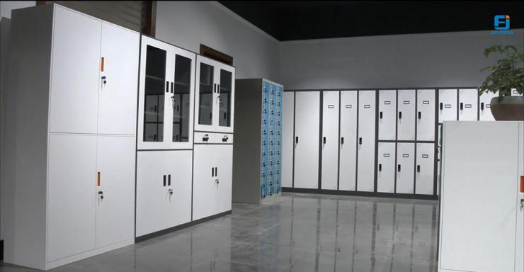
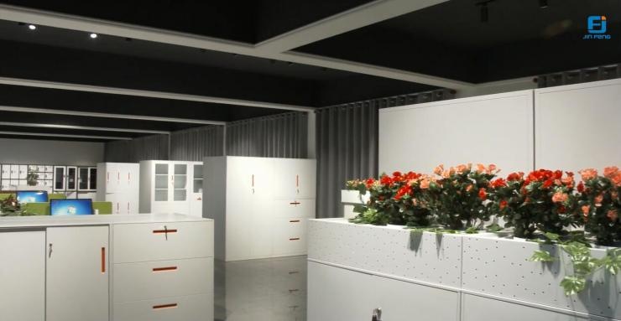
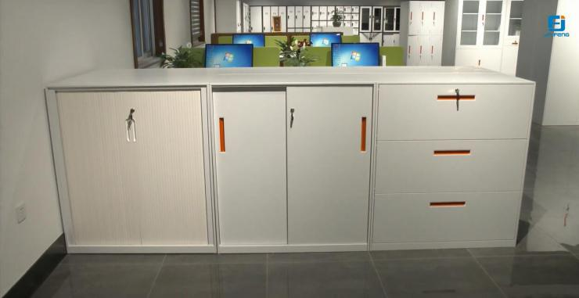
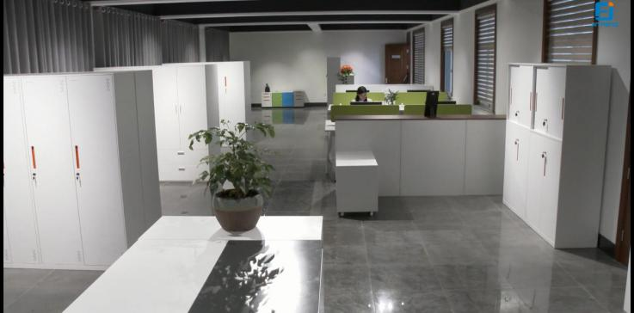
Show Room
Click the picture to visit our show room on line.

Slide 40
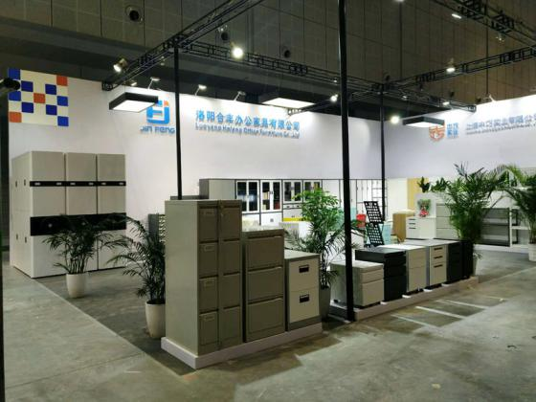
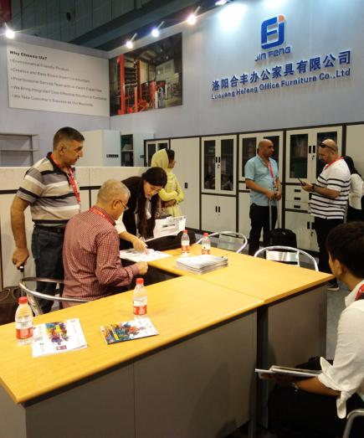
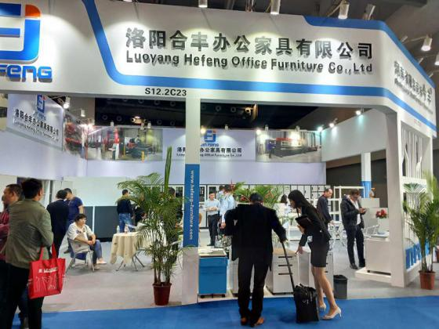
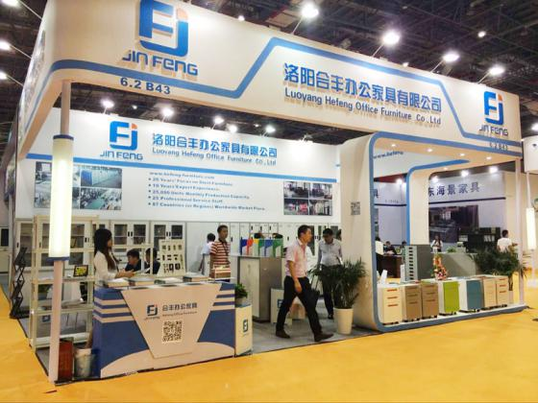
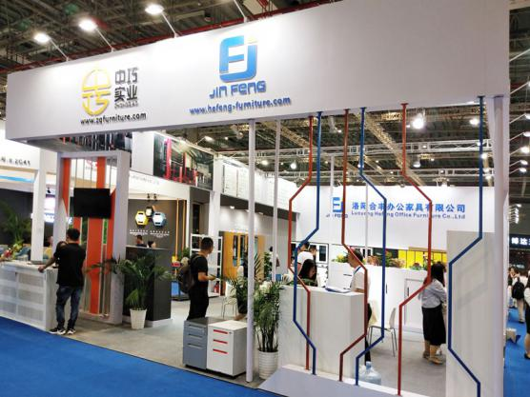
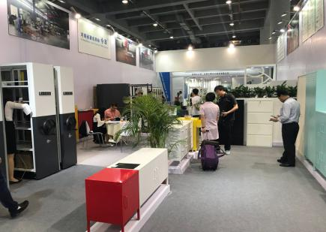
Exhibition Shows
Meet Us at Furniture Fairs

Slide 41
PART
04
Export
Market

Slide 42
Export Market
Europe
North America
Asia
Africa
Australia
South America
Besides the domestic market, products made by Hefeng have been exporting to Europe, North America, South Amercia, Africa, Asia, Austrila for 11 years.

Slide 43
Main Market
51%
Europe
Nearly half of our products are exported to Germany, France, Netherlands, Poland, Hungary, Czech, Spain, Romania etc.
29%
America
We contribute an in-depth understanding of American market and expand our business, especially the products with mail order packing in America.
13%
South America
We have been working with custmoers in Chile, Brazil, Panama, Argentina, etc for years, and undertook some projects related with steel cabinets.

Slide 44
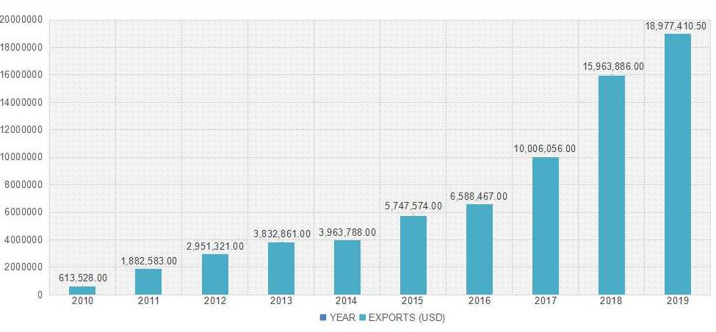
Sales Statistics
Unit：USD
Over the past 10 years, Hefeng has invested more than $10 million in importing advanced equipment, improving quality control and management, which experienced steady growth of market sales.

Slide 45
Sales Service
24/7 Service
Dedicated service
Your sales represatative will be responsable for any questions, concerns, damages or other issues from the very beginning of communication.
5 Years' Warranty
Our products are warranted to be free from defects in design, materials and workmanship for a fixed period of time as five (5) years from date of delivery.
Exclusive customer service
We assuring you of our best services at all time.
Always refer to our invoice number, model number when contacting us. If required,we will replace the defected product for customers.

Slide 46
PART
05
Contact
Us

Slide 47
Why Choose Us?
Work out the details to achieve your dreams.
With the goal of creating high-quality office environments and the belief that “Quality will change lives” in heart, Hefeng people spare no effort to perfect the details, strive for excellence, and achieve the ultimate result.
· Environmentally friendly product
· Creative and easy knock down construction
· Professional service team with in-depth expertise
· We bring integrated cost-effective solution to customer
· We take customer's success as our business
Environmentally Friendly Product

Slide 48
Contact Information
If you have any inquiry or question, please feel free to contact us via phone or email below, you will receive our fast reply with precise quotation and professional answers.
Mobile: +86-186 3796 8137
Office: +86 (0) 379 6321 5281
Email: janet@hefeng-furniture.com
Website: www.hefeng-furniture.com
Janet Zhang
Sales Manager

Slide 49
ISO Certificated
THANK YOU
- Luoyang Hefeng Office Furniture Co., Ltd
23 Years' Focus on Steel Furniture

